Slide 1
19CS3113S Analysis and Design of Algorithms
Session -3
Asymptotic notations

Slide 2
Asymptotic efficiency
Asymptotic efficiency means study of algorithms efficiency for large inputs.
To compare two algorithms with running times f(n) and g(n), we need a rough measure that characterizes how fast each function grows as n grows.
Hint: use rate of growth
Compare functions asymptotically!
(i.e., for large values of n)

Slide 3
Functions ordered by growth rate
Function | Name
1 | Growth is constant
logn | Growth is logarithmic
n | Growth is linear
nlogn | Growth is n-log-n
n² | Growth is quadratic
n³ | Growth is cubic
2^{n} | Growth is exponential
n! | Growth is factorial
1 < logn < n < nlogn < n² < n³ < 2^{n} < n!

Slide 4
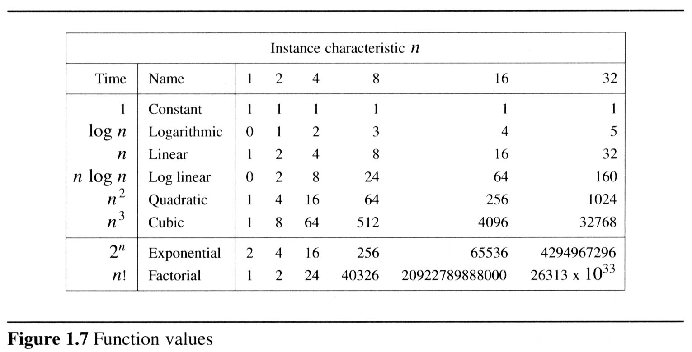
To get a feel for how the various functions grow with n, you are advised to study the following figs:

Slide 5
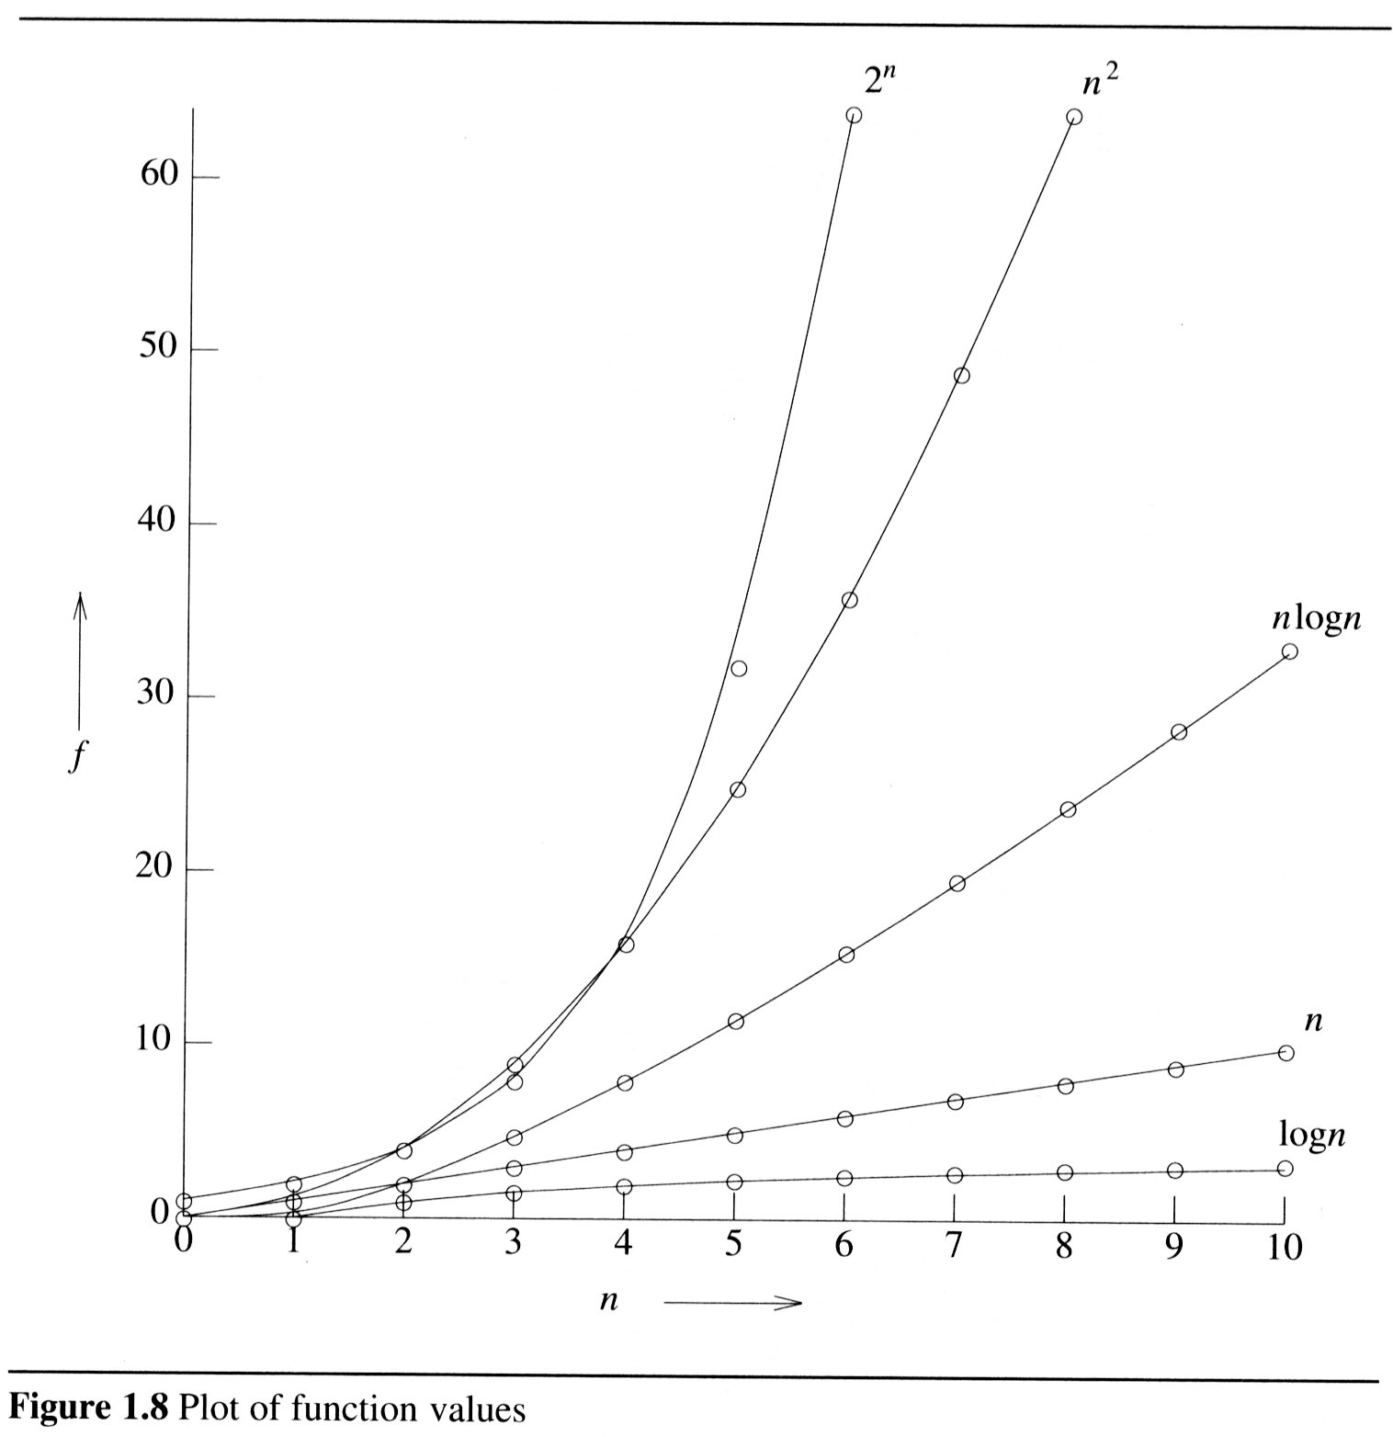
2

Slide 6
The low order terms and constants in a function are relatively insignificant for large n
n² + 100n + log₁₀n + 1000 ~ n²
i.e., we say that n² + 100n + log₁₀n + 1000 and n² have the same rate of growth
Some more examples
n⁴ + 100n² + 10n + 50 is ~ n⁴
10n³ + 2n² is ~ n³
n³ - n² is ~ n³
constants
10 is ~ 1
1273 is ~ 1

Slide 7
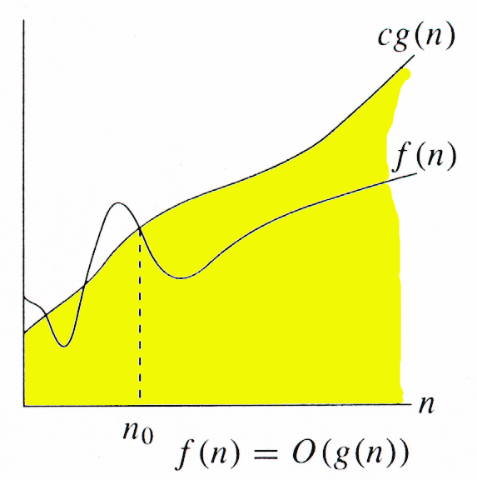
Asymptotic/order Notations
Asymptotic/order notation describes the behavior of functions for the large inputs.
Big Oh(O) notation:
The big oh notation describes an upper bound on the asymptotic growth rate of the function f.
Definition: [Big “oh’’]
f(n) = O(g(n)) (read as “f of n is big oh of g of n”) iff there exist positive constants c and n₀ such that
f(n) ≤ cg(n) for all n, n ≥ n₀.

Slide 8
The definition states that the function f(n) is at most c times the function g(n) except when n is smaller than n₀.
In other words, f(n) grows slower than or same rate as” g(n).
When providing an upper –bound function g for f, we normally use a single term in n.
Examples
f(n) = 3n+2
3n + 2 <= 4n, for all n >= 2, ∴3n + 2 = Ο (n)
f(n) = 10n²+4n+2
10n²+4n+2 <= 11n², for all n >= 5, ∴ 10n²+4n+2 = Ο (n²)
f(n)=6*2^{n}+n²=O(2^{n}) /* 6*2^{n}+n² ≤7*2^{n} for n≥4 */

Slide 9
It also possible to write 10n²+4n+2 = O(n³) since 10n²+4n+2 <=7n³ for n>=2
Although n³ is an upper bound for 10n²+4n+2, it is not a tight upper bound; we can find a smaller function (n²⁾ that satisfies big oh relation.
But, we can not write 10n²+4n+2 =O(n), since it does not satisfy the big oh relation for sufficiently large input.

Slide 10
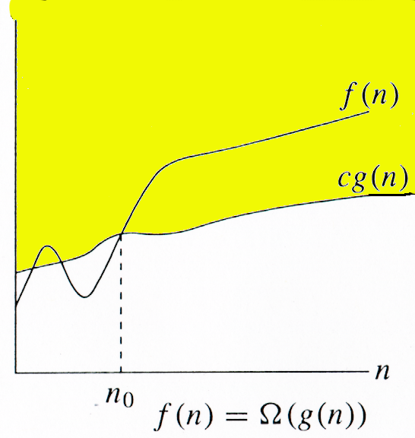
Omega (Ω) notation:
The omega notation describes a lower bound on the asymptotic growth rate of the function f.
Definition: [Omega]
f(n) = Ω(g(n)) (read as “f of n is omega of g of n”) iff there exist positive constants c and n₀ such that f(n) ≥ cg(n) for all n,
n ≥ n₀.

Slide 11
The definition states that the function f(n) is at least c times the function g(n) except when n is smaller than n₀.
In other words,f(n) grows faster than or same rate as” g(n).
Examples
f(n) = 3n+2
3n + 2 >= 3n, for all n >= 1, ∴3n + 2 = Ω (n)
f(n) = 10n²+4n+2
10n²+4n+2 >= n², for all n >= 1, ∴ 10n²+4n+2 = Ω (n²)
It also possible to write 10n²+4n+2 = Ω(n) since 10n²+4n+2 >=n for n>=0
Although n is a lower bound for 10n²+4n+2, it is not a tight lower bound; we can find a larger function (n²⁾ that satisfies omega relation.
But, we can not write 10n²+4n+2 = Ω(n³), since it does not satisfy the omega relation for sufficiently large input.

Slide 12
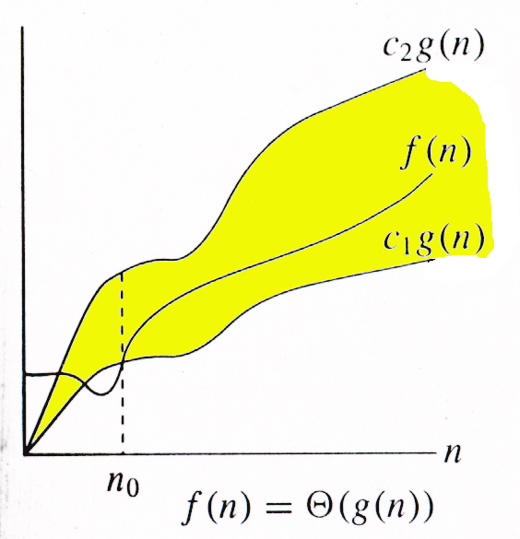
Theta (Θ) notation:
The Theta notation describes a tight bound on the asymptotic growth rate of the function f.
Definition: [Theta]
f(n) = Θ(g(n)) (read as “f of n is theta of g of n”) iff there exist positive constants c₁, c₂, and n₀ such that c₁g(n) ≤ f(n) ≤ c₂g(n) for all n, n ≥ n₀.

Slide 13
The definition states that the function f(n) lies between c1 times the function g(n) and c2 times the function g(n) except when n is smaller than n₀.
In other words,f(n) grows same rate as” g(n).
Examples:-
f(n) = 3n+2
3n <= 3n + 2 <= 4n, for all n >= 2, ∴ 3n + 2 = Θ (n)
f(n) = 10n²+4n+2
n²<= 10n²+4n+2 <= 11n², for all n >= 5, ∴ 10n²+4n+2 = Θ (n²)
But, we can not write either 10n²+4n+2= Θ(n) or 10n²+4n+2= Θ(n³), since neither of these will satisfy the theta relation.

Slide 14
Big-Oh, Theta, Omega
Tips :
Think of O(g(n)) as “less than or equal to” g(n)
Upper bound: “grows slower than or same rate as” g(n)
Think of Ω(g(n)) as “greater than or equal to” g(n)
Lower bound: “grows faster than or same rate as” g(n)
Think of Θ(g(n)) as “equal to” g(n)
“Tight” bound: same growth rate
(True for large N)

Slide 15
Example 1 - Iterative sum of n numbers
Statement | s/e | frequency | Total steps
Algorithm sum(a, n) { s:=0 ; for i:=1 to n do s:=s+a[i]; return s; } | 0 0 1 1 1 1 0 | -- -- 1 n+1 n 1 -- | 0 0 O(1) O(n+1) O(n) O(1) 0
Total |  |  | O(n)

Slide 16
Example 2 - Addition of two m×n matrices
Statement | s/e | frequency | Total steps
Algorithm Add(a,b,c,m, n) { for i:=1 to m do for j:=1 to n do c[i,j]:=a[i,j]+b[i,j] ; } | 0 0 1 1 1 0 | -- -- m+1 m(n+1) mn -- | 0 0 O(m) O(mn) O(mn) 0
Total |  |  | O(mn)

Slide 17
Time complexity of Towers of Hanoi
T(n) = T(n-1) + 1 + T(n-1) = 2T(n-1) + 1
= 2 * ( 2 * T(n-2) + 1) + 1
= (2 ^ 2) * T(n-2) + 2^1 + 2^0
:
= (2^k) * T(n-k) + 2^(k-1) + 2^(k-2) + ... + 2^0
Base condition T(0) == 1 n – k = 0 => n = k; put, k = n
T(n)=2^n T(0)+2^(n-1)+....+2^1+2^0
It is GP series, and sum is 2^(n+1)-1 T(n) = O(2^n) which is exponential.

Slide 18
Thank you

